Slide 1

Capstone Project
ML Saints
Abhijit Khatkar | Aarti Palande | Manisha Upendra | Praveen Shekar

Slide 2
Problem Statement
Geo location Based Analysis Generate meaningful insights on Geolocation based customer & revenue analysis.
Market Segmentation Divide the customer base into segments based on their car type, service type & total spend such that these customers will respond similarly to the different marketing campaigns.
Customer Lifetime Value Prediction Life time value analysis of customers to maintain relationship with high profit generating customers in future & finding potential customers from the population.

Slide 3
Mahindra First Choice
MFCS is a group company of Mahindra.
India’s leading chain of multi-brand car workshops with 335+ workshops present in 267+ towns and 24 states.
List of Services provided by MFCS:
Periodic maintenance services
Running repairs
Body repair
Warranty beyond warranty
Car care
Wheel care
Private label spare parts for all brand cars under the name MFC.

Slide 4
Data In-Hand
Dataset | Format | Rows | Columns | Description
Invoice | csv | 4,92,314 | 59 | Customer Transactions
Customer | excel | 5,55,338 | 9 | Customer data
JTD | csv | 56,19,484 | 10 | Data of parts
Plant | excel | 438 | 13 | Plant location and details

Slide 5
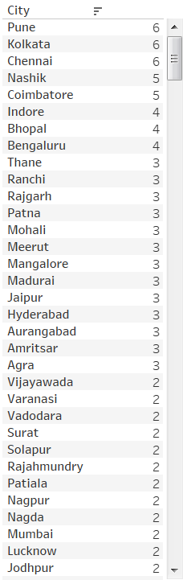
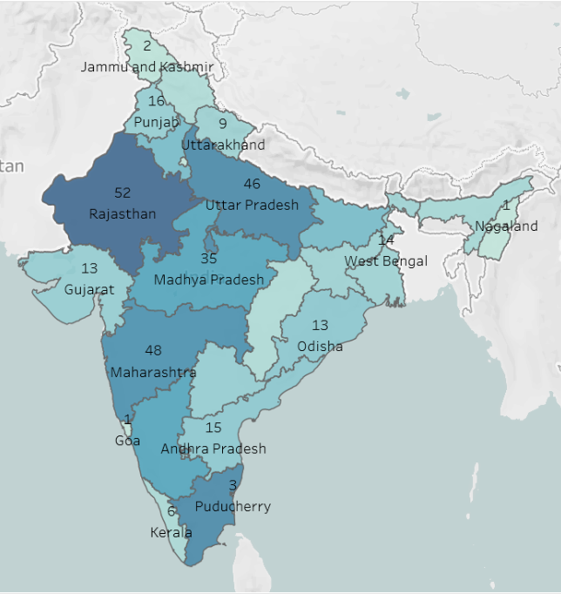
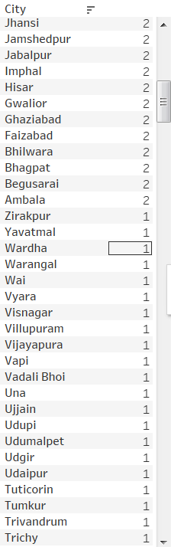
Plant Location

Slide 6
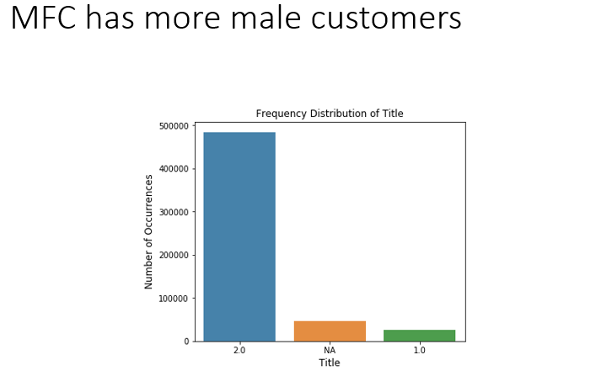
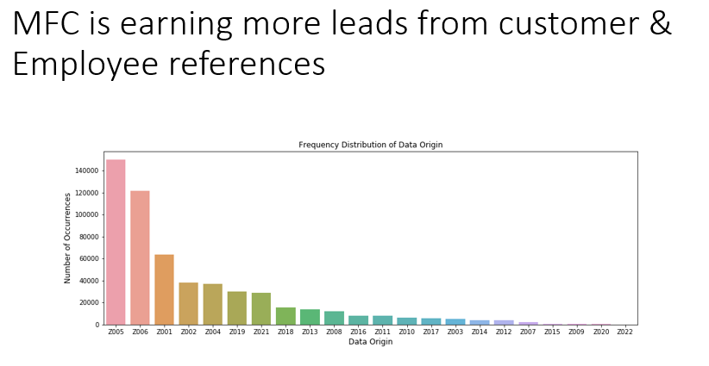
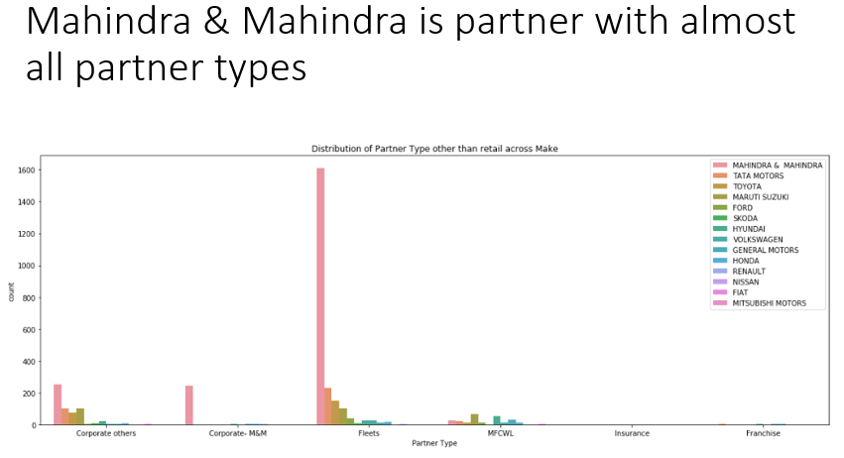
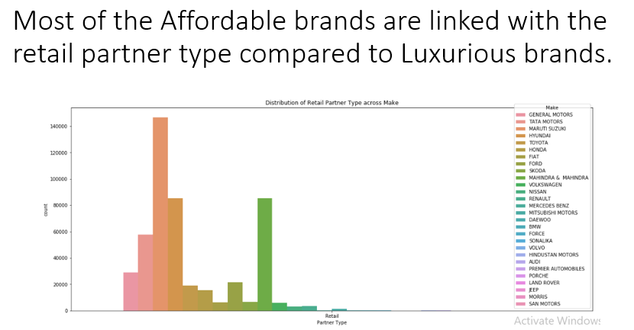
Customer Demographics

Slide 7
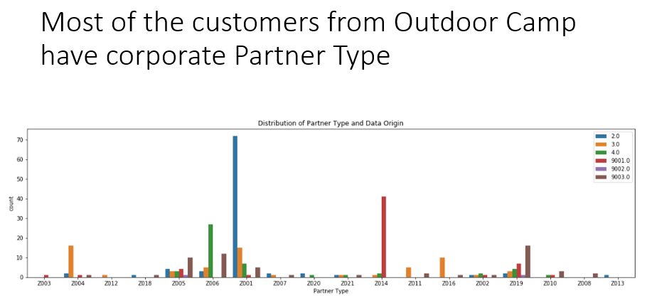

Slide 8
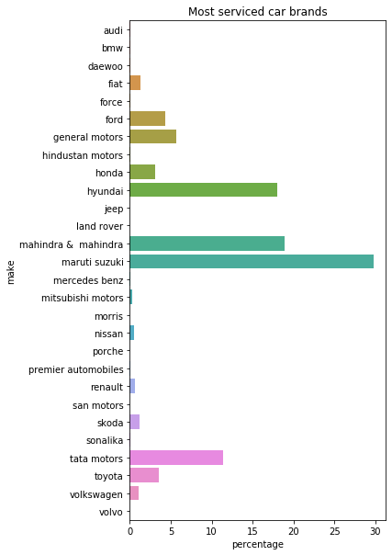
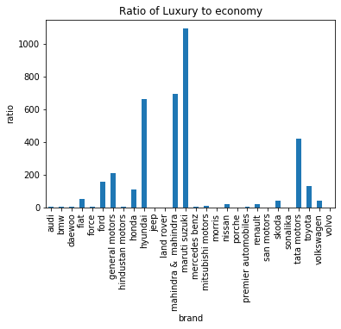
Car Brnds
Car Brands

Slide 9
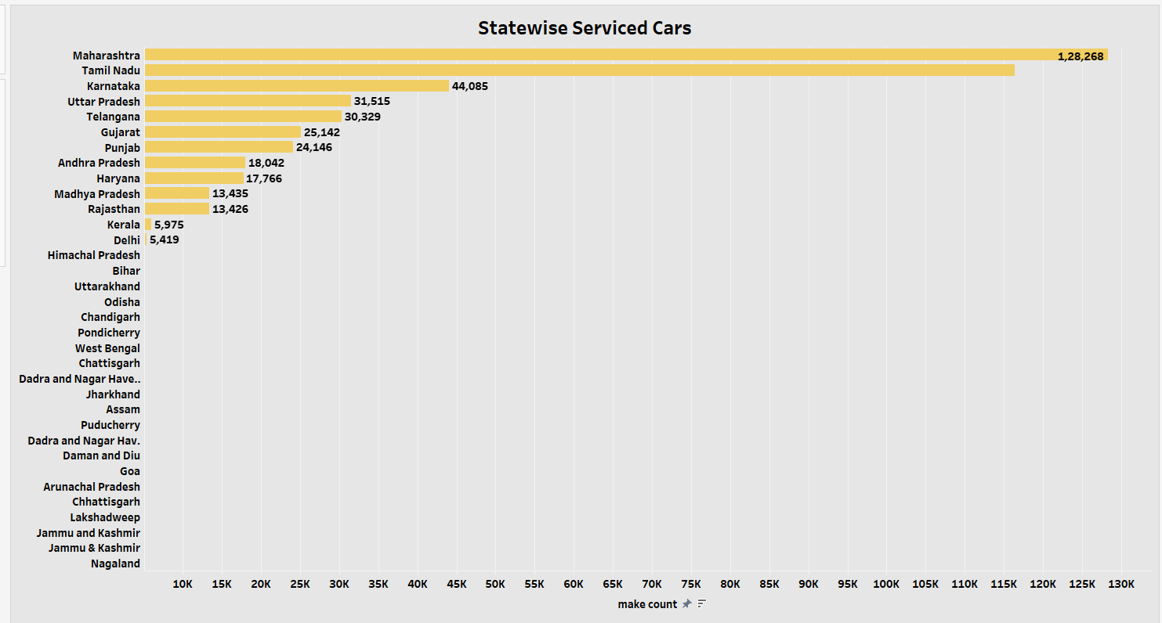
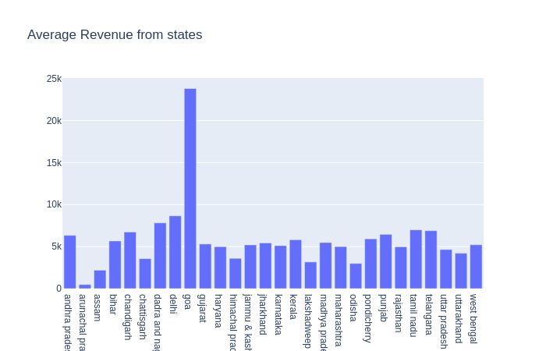

Slide 10
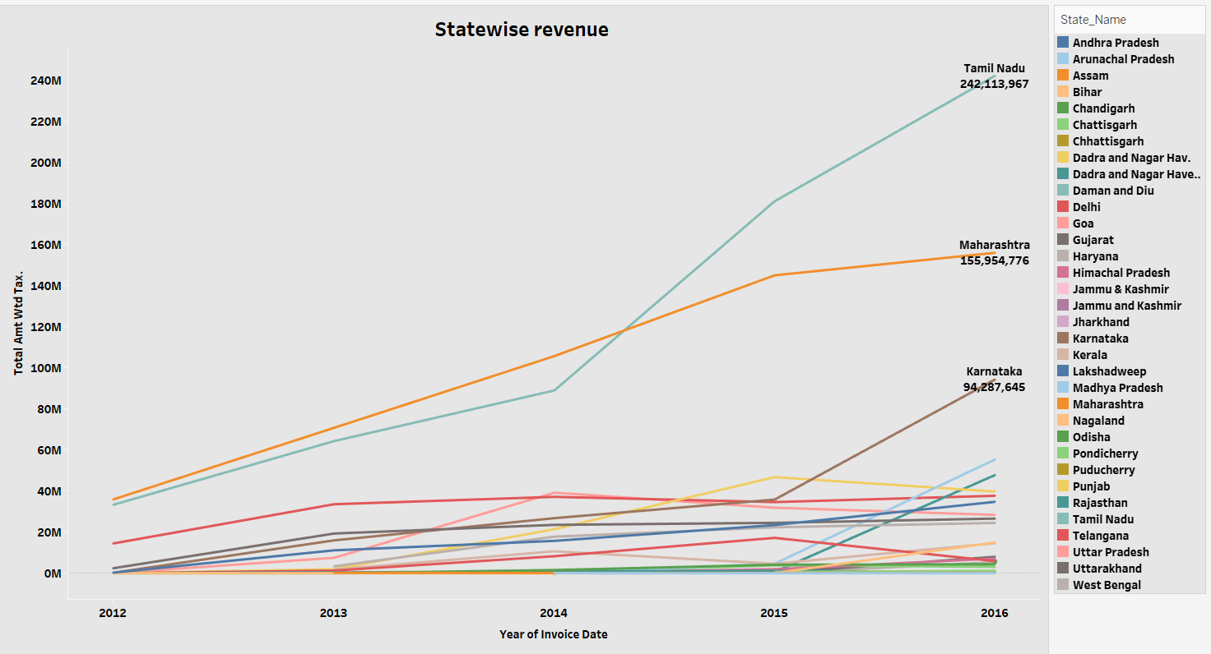

Slide 11
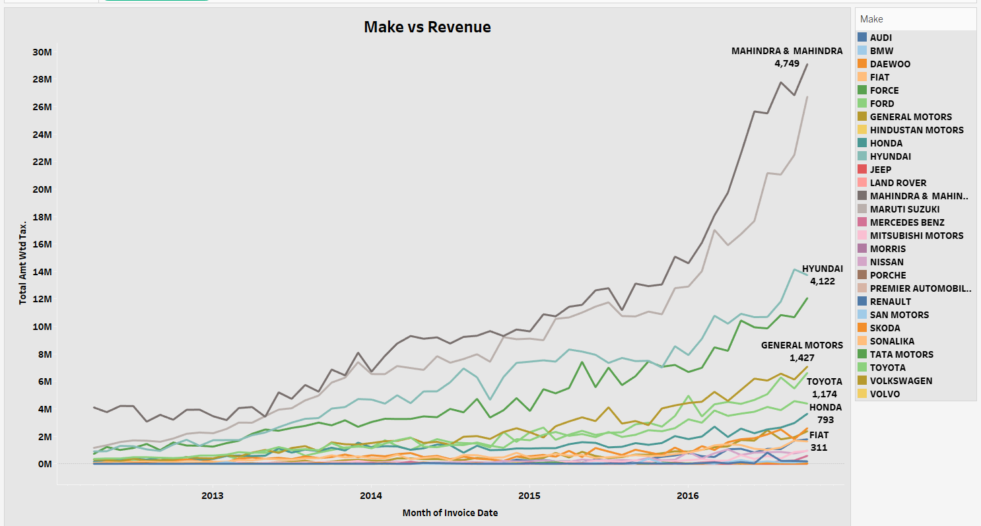

Slide 12
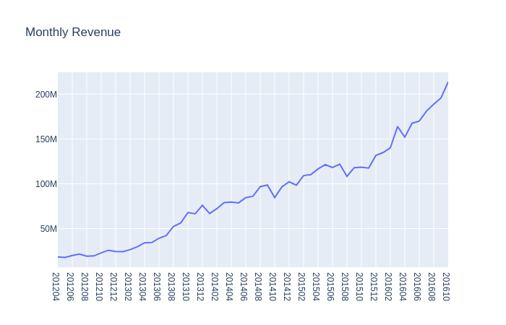
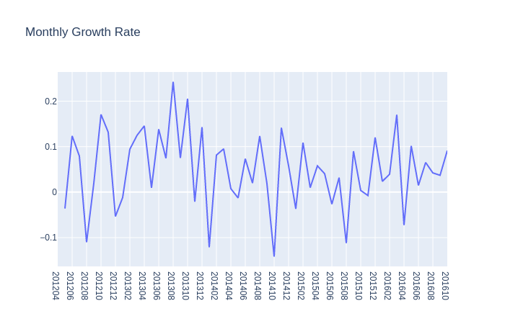
Monthly Revenue

Slide 13
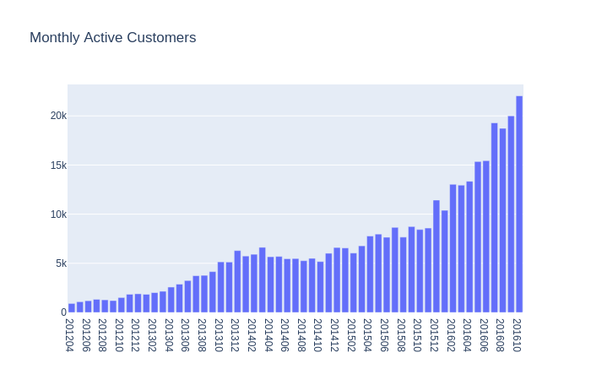
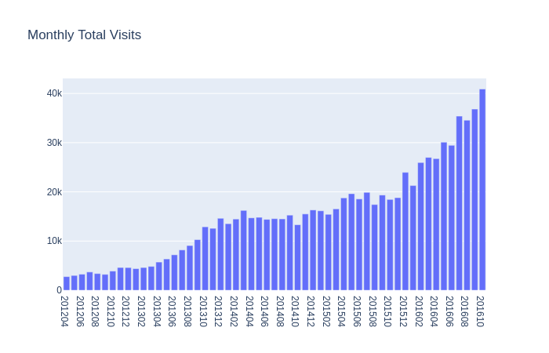
Monthly Customer data

Slide 14
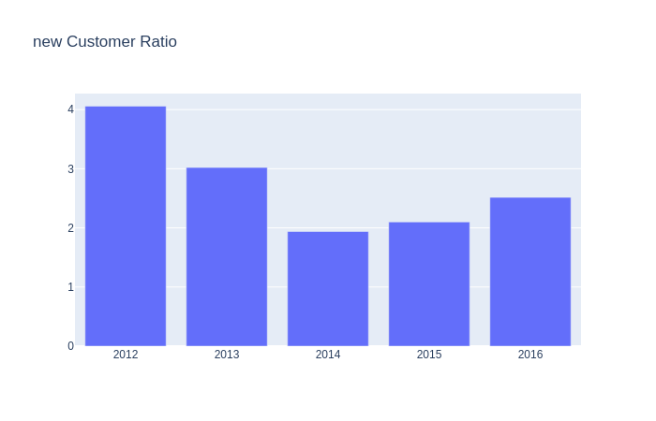
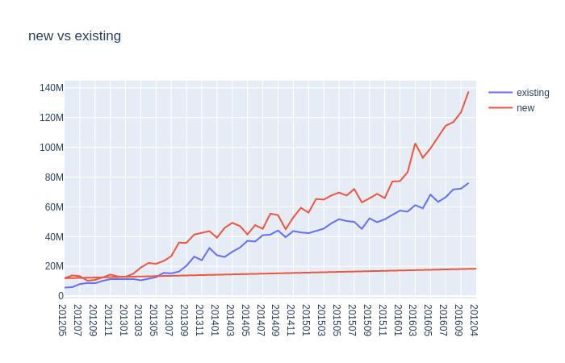
Customer Priority

Slide 15
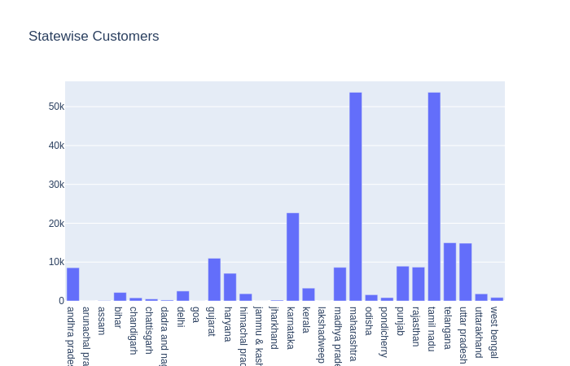
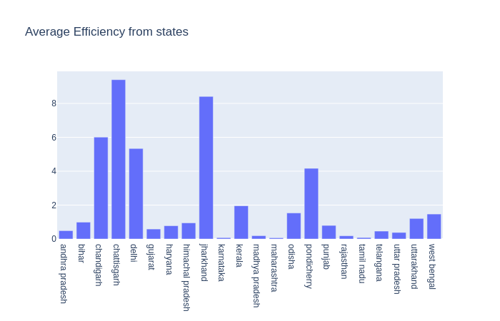
Efficiency of plants

Slide 16
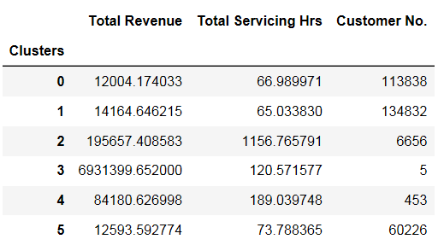
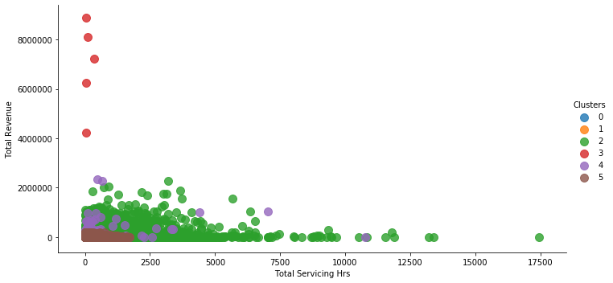
Market Segmentation

Slide 17
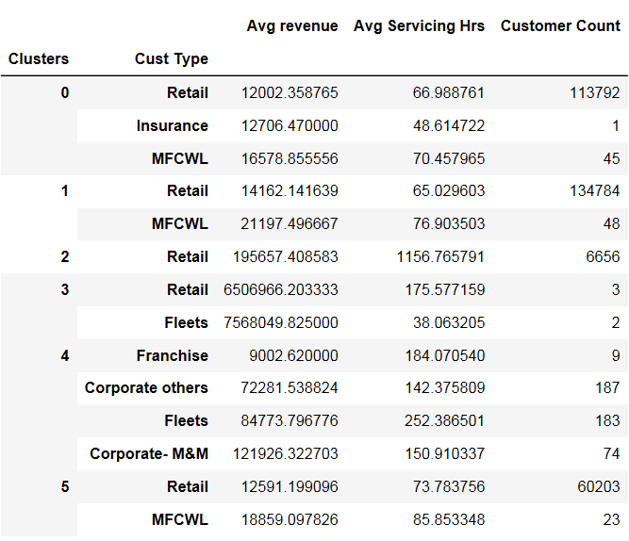
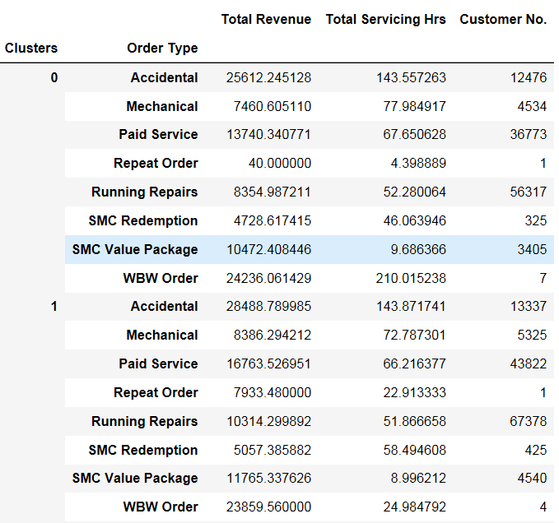
Market segmentation

Slide 18
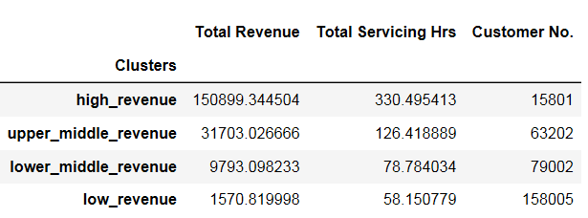
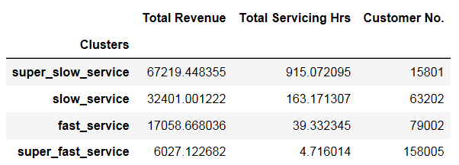
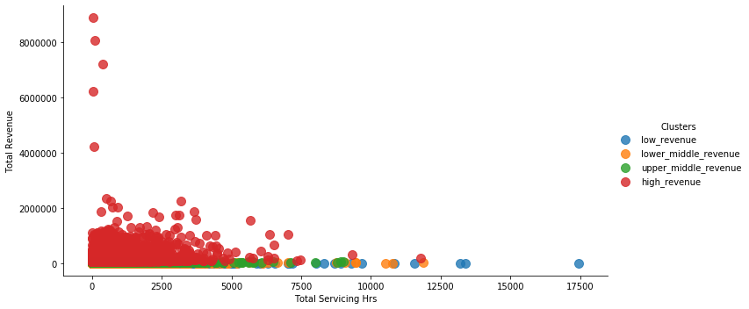
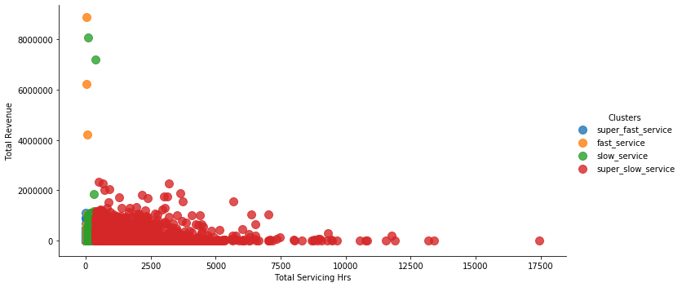
Rule based clustering

Slide 19
Customer Lifetime Value
Customer Lifetime Value or LTV is a metric used by organisations that directly interact with customers to determine their value.
Data considered for LTV prediction was for the year 2016
It is calculated as follows
LTV = average purchase frequency * average expenditure per visit.

Slide 20
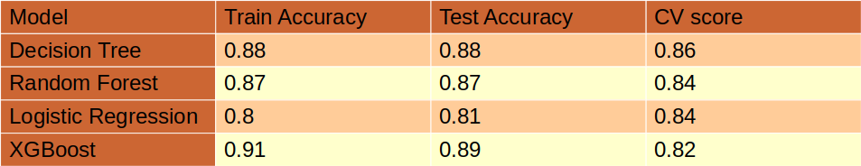
Accuracy obtained
Customer Segments | Range
Low Value Customer | 0 - 2281
Mid Value Customer | 2282 - 6662
High Value Customer | 6663 - 1790744

Slide 21
Decisions
Define the customers from Uttar Pradesh and Rajasthan.
Stock spare parts for Indian car companies.
More plants in Maharashtra and Tamil Nadu.
A study of operations should be done on the plants in Maharashtra, Karnataka and Tamil Nadu.
Feedback for services provided.

Slide 22
THANK YOU

